Slide 1
Local repository 관련 구조
Working directory
Add
Staging Area
Commit
Local Repository

Slide 2
Git 했던거
Git init : 로컬 저장소를 초기화 한다.
Git status : 현재 상태를 확인.
Git add : 변화된 것 반영 준비.
Git commit : 변화된 것을 로컬 저장소에 올림.
Git log : commit 되었던 list 가 출력 됨.
Git reset --(hard/mixed/soft) commitID : commitID로 reset
Git branch : branch list
Git branch branchname : branch 생성
Git branch –(d/D) branchname : branch 삭제 (D 일 경우 강제 삭제)
Git checkout branchname : branch 로 넘어가기
Git merge branchname : 현재 branch로 branchname 내용 merge
Git stash : 현재 working directory 내용을 저장하고 working directory 는 현재 branch의 마지막 commit id 상태로 되돌린다.
Git stash list : stash 된 list를 보여준다.
Git stash apply : 가장 최근에 stash 된 내용으로 working directory를 바꾼다. 단, stash list 는 그대로 유지한다.
Git stash pop : 가장 최근에 stash 된 내용으로 working director를 바꾼다. 복원된 내용은 stash list 에서 pop 된다.

Slide 3
master
Git은 결국 commit id 로 이루어진 tree 와 흡사한 구조를 가짐
9822c
2ed97
d1b0e
9a29d
35e87
84da2
hotfix

Slide 4
a.txt
1
2
3
4
5
6
Commit ID
C1
C2
C3
C4
C5

Slide 5
a.txt
a
b
c
d
e
f
Commit ID
C1
C2
C3
C4
C5

Slide 6
a.txt
2
3
4
5
6
Commit ID
C3
C4
C5
C1
C2

Slide 7
(1)
(2)
(3)
(4)
(5)
(6)
(7)
(8)
(9)
(10)
(11)
(12)
vim a.txt; //1
git add a.txt; git commit; //ID C1
vim a.txt; //2
git add a.txt; git commit; //ID C2
git branch test;
vim a.txt; //3
git add a.txt; git commit; //ID C3
git checkout test;
vim b.txt; //1
git add b.txt; git commit; //ID C4
vim b.txt; //2
git add b.txt; git commit; //ID C5
(13)
(14)
(15)
(16)
(17)
(18)
(19)
(20)
(21)
(22)
(23)
(24)
git branch test_sub;
git checkout test_sub;
vim c.txt; //1
git add c.txt; git commit; //ID C6
git checkout test;
git merge test_sub;
git branch –d test_sub;
git checkout master;
git merge test;
git checkout test;
vim b.txt; //3
git add b.txt; git commit; //ID C7

Slide 8
(1)
(2)
(3)
(4)
(5)
(6)
(7)
(8)
(9)
(10)
(11)
(12)
vim a.txt; //a
git add a.txt; git commit; //ID C1
vim a.txt; //b
git add a.txt; git commit; //ID C2
git branch test;
vim a.txt; //c
git add a.txt; git commit; //ID C3
git checkout test;
vim b.txt; //d
git add b.txt; git commit; //ID C4
vim b.txt; //e
git add b.txt; git commit; //ID C5
(13)
(14)
(15)
(16)
(17)
(18)
(19)
(20)
(21)
(22)
(23)
(24)
git branch test_sub;
git checkout test_sub;
vim c.txt; //f
git add c.txt; git commit; //ID C6
git checkout test;
git merge test_sub;
git branch –d test_sub;
git checkout master;
git merge test;
git checkout test;
vim b.txt; //g
git add b.txt; git commit; //ID C7

Slide 9
master
C1
C2
C3
M2
a.txt : 1
a.txt : 2
a.txt : 3
a.txt : 3
b.txt : 2
c.txt : 1
C4
C5
M1
a.txt : 2
b.txt : 1
a.txt : 2
b.txt : 2
a.txt : 2
b.txt : 2
c.txt : 1
C6
test
a.txt : 2
b.txt : 2
c.txt : 1
C6
a.txt : 2
b.txt : 3
c.txt : 1
test_sub

Slide 10
master
a.txt : a
a.txt : b
(2)
(4)
(7)
(21)
C1
C2
C3
M2
a.txt : c
a.txt : c
b.txt : e
c.txt : f
a.txt : b
b.txt : d
a.txt : b
b.txt : e
a.txt : b
b.txt : e
c.txt : f
(10)
(12)
(18)
C4
C5
M1
a.txt : b
b.txt : e
c.txt : f
a.txt : b
b.txt : g
c.txt : f
(16)
C6
(24)
C7
test
test_sub

Slide 11
Merge conflict 해결
master
C3
a.txt : 1
a.txt : 3
C1
Merge 시
conflict
a.txt : 2
C2
test

Slide 12
Fast forward
master
master
C1
a.txt : 1
test
C2
a.txt : 2

Slide 13
M1
3 way merge
base
할놈
될놈
Merge 필요
2
4 O
3 O
할놈
C4
C6
master
base
a.txt : 4
a.txt : 5
C1
C2
M1
M2
a.txt : 1
a.txt : 2
a.txt : 4
test
a.txt : 5
b.txt : 1
될놈
C3
C5
a.txt : 3
a.txt : 4
b.txt : 1

Slide 14
Git hosting
Provider | Framework is open-source? | Support for other SCM | Open-source repositories | Space (GB) | Free private repositories
Beanstalk | No | SVN | No | 0.1 | 1 projects, 1 user
bitbucket.org | No | Mercurial | Yes | Unlimited | Unlimited projects, 5 collaborators
Codebase | No | Mercurial/SVN | Public access available | 0.05 | 1 project (unlimited repos), 2 collaborators
Helix TeamHub | No | Mercurial/SVN | No | 1 | Unlimited projects, 5 users
GitHub | No | SVN | Yes | Unlimited | No
GitLab.com | Yes | No | Yes | Unlimited | Unlimited projects, unlimited collaborators
Pikacode | No | Mercurial | Yes | 1 | No
ProjectLocker | No | SVN | Read-only http | 0.05 | 1 project, 1 collaborators
repo.or.cz | Yes | No | Yes | 0.4 | No
RocketGit | Yes | No | Yes | Unlimited | Unlimited
SourceForge.net | Yes | Hg, SVN | Yes | Unlimited | No
Unfuddle | No | SVN | Yes | 0.2 | 1 project, 2 collaborators
Visual Studio Team Services | No | TFVC | No | Unlimited | Unlimited, 5 users

Slide 15
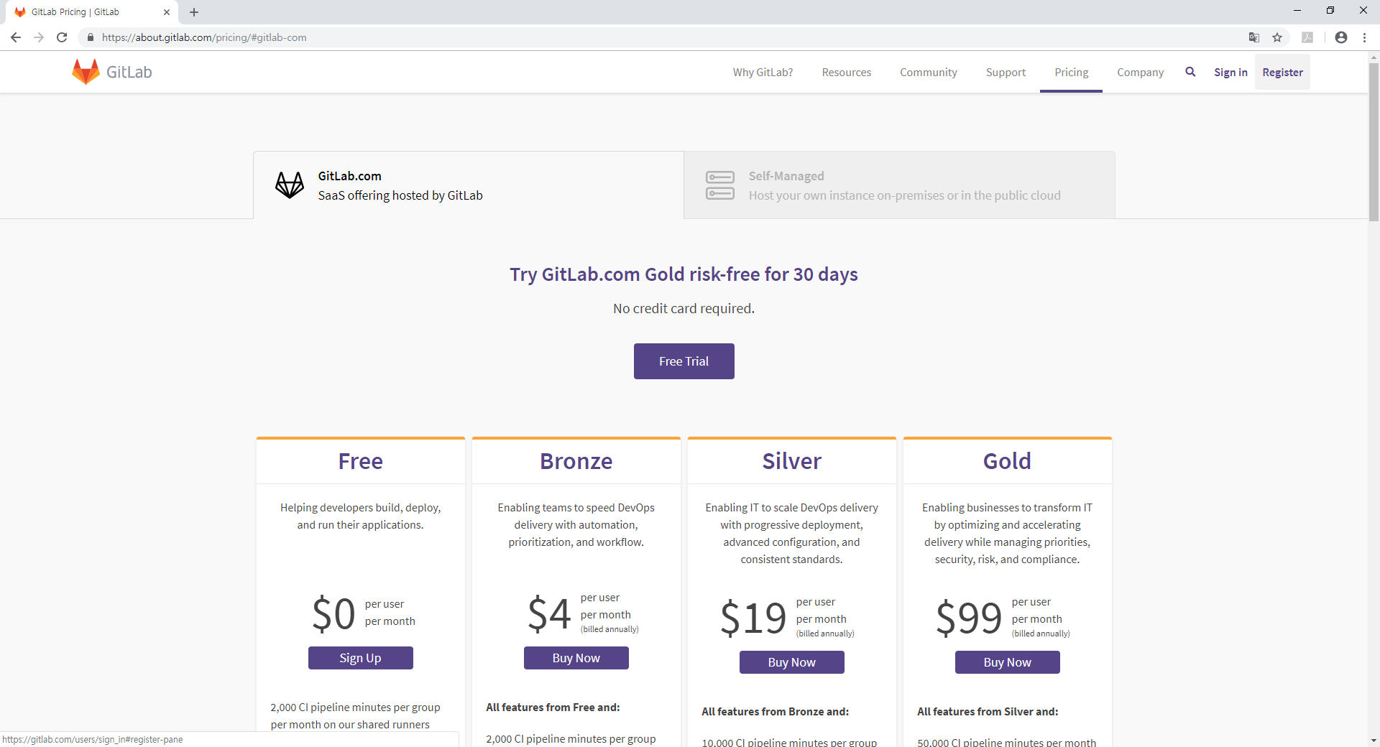

Slide 16
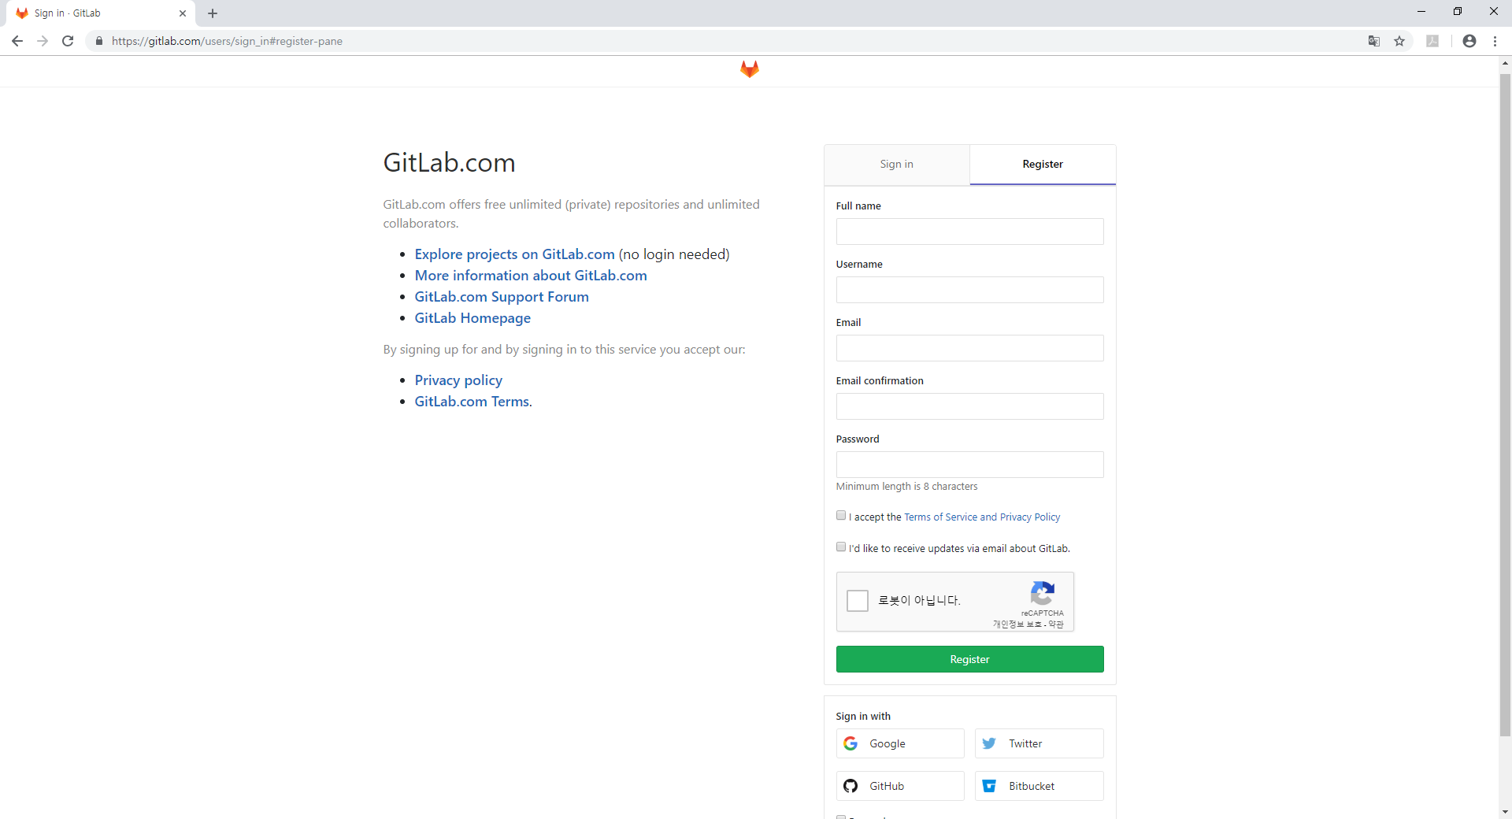

Slide 17
(0) vim a.txt; //a
git add a.txt; git commit; //C1
git branch sub1;
git checkout sub1;
vim a.txt; //b
git add a.txt; git commit; //C2
git checkout master;
git merge sub1;
git branch –d sub1;
git branch sub2;
vim b.txt; //b
git add b.txt; git commit; //C3
git checkout sub2;
vim c.txt; //c
git checkout master;
git merge sub2;
git checkout sub2;
git add c.txt; git commit; //C4
vim a.txt; //c
git add a.txt; git commit; //C5
git checkout master;
git merge sub2;
(22)git branch sub3;
(23)vim b.txt; //c
(24)git add b.txt; git commit; //C6
(25)git checkout sub3;
(26)vim b.txt; //d
(27)git add b.txt; git commit; //C7
(28)vim c.txt; //d
(29)git stash;
(30)git checkout master;
(31)git merge sub3;
(32)git checkout sub3;
(33)git stash apply;
(34)git add .; git commit; //C8
(35)git checkout master;
(36)vim a.txt; //d
(37)git add .; git commit; //C9
(38)git checkout sub3;
(39)vim a.txt; //e
(40)git add .; git commit; //C10
(41)git checkout master;
(42)git merge sub3;

